Slide 1
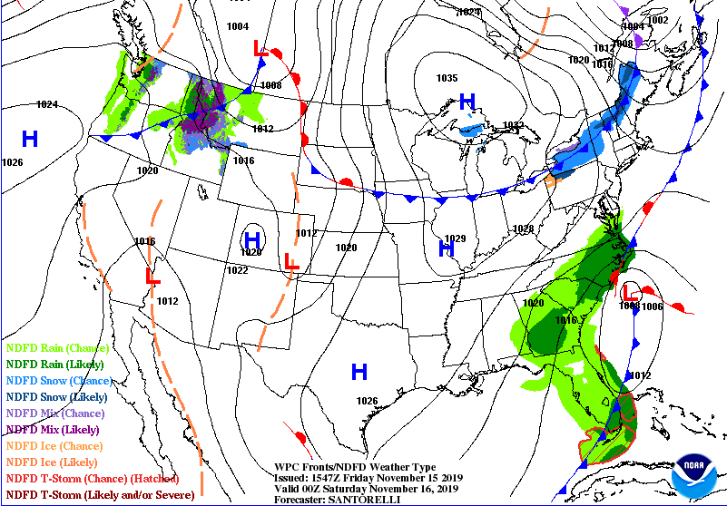
National Weather Service
Wilmington, NC
Outlook Period: 11/15/19 – 11/17/19
Time Issued: 11:30 AM 11/15/19
Prepared by: Stephen Keebler
Forecaster #: 910-762-4289
Overview: Rain and wind can be expected across the area most of the weekend as a series of low pressure systems move just offshore.
Primary Threat: Heavy rain and wind. Additional rainfall amounts of 2-3 inches can be expected through late Sunday. Strong northerly winds of 15-25 mph sustained with higher gusts can be expected through Sunday as well. There is a Wind Advisory for the coastal counties and Gale Warning for the coastal waters.
Impacts: Some minor flooding and power outages are the primary threats.
The image below is the surface map forecast for Friday evening.
For the latest updates, please visit our website and social media outlets:
www.weather.gov/ilm
fb.com/US.NationalWeatherService.WilmingtonNC.gov
@NWSWilmingtonNC

Slide 2
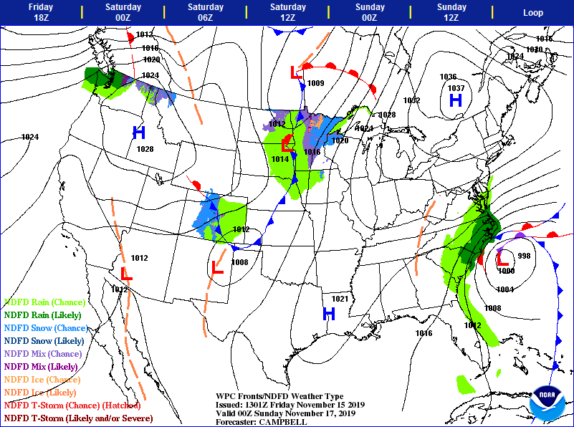
National Weather Service
Wilmington, NC
Outlook Period: 11/15/19 – 11/17/19
Time Issued: 11:30 AM 11/15/19
Prepared by: Stephen Keebler
Forecaster #: 910-762-4289
The image below is the surface map forecast for Saturday evening.
For the latest updates, please visit our website and social media outlets:
www.weather.gov/ilm
fb.com/US.NationalWeatherService.WilmingtonNC.gov
@NWSWilmingtonNC

