Slide 1
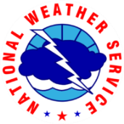
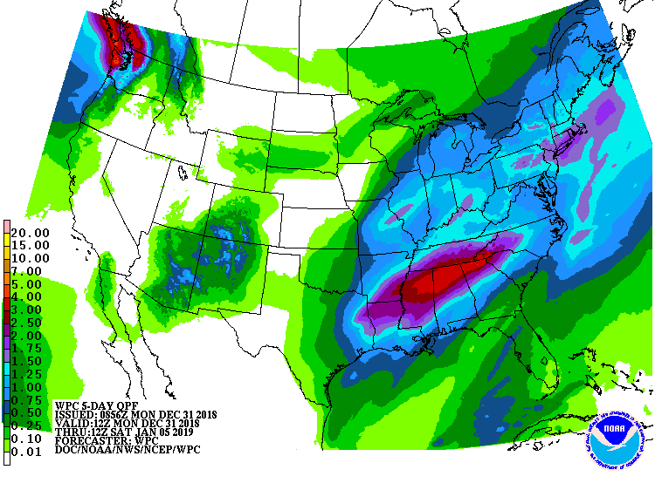
National Weather Service
Wilmington, NC
Outlook Period: 12/31/2018-1/4/2019
Time Issued: 9:30 AM EST 12/31/2018
Prepared by: Terry Lebo
Forecaster #: 910-762-4289
Overview:
A warm front will lift north across the area today.
Slow moving cold front will move into the region late Tuesday.
The front will stall just south of the area Wednesday and Thursday.
A complex storm system will move from the Gulf Coast Thursday morning to the Mid-Atlantic states on Friday, passing west of the area.
Between half an inch and an inch of rain expected this week, with most falling on Wednesday and Thursday.
Temperatures will be above to well above normal through the week.
Primary Threat: No threats are anticipated
www.weather.gov/ilm
fb.com/US.NationalWeatherService.WilmingtonNC.gov
@NWSWilmingtonNC

